Slide 1
Data Pre-processing: Clean, Reduce and Transform
Anran Zhao
Research Associate at UK Data Service
Email: anran.zhao@manchester.ac.uk
Copyright © [year] UK Data Service. Created by [Organisation], [Institution]

Slide 2

Can you hear us?
Notes:
You should see a poll on your screen around about now. And if you can answer whether you can hear us or not…
Yes
No

Slide 3
Can you hear us?
If not:
Check your speaker/headset is plugged in / volume is on.
Click on audio to change to listening via phone
We are recording this webinar and will post it on YouTube (https://www.youtube.com/user/UKDATASERVICE)
Notes:
Also, although we cannot hear you during the talk, we’ll have a Q&A session later and answer the questions. Meanwhile you are welcomed to leave your questions in the Q&A box throughout the talk, my colleague Julia and Joe will answer it directly there, if it’s not too complicated. Or she might leave it to the Q&A session so don’t worry

Slide 4
Data Pre-processing: Clean, Reduce and Transform
Anran Zhao
Research Associate at UK Data Service
Email: anran.zhao@manchester.ac.uk
Copyright © [year] UK Data Service. Created by [Organisation], [Institution]

Slide 5
Table of Content
Definition, context, and collecting data
Data integration (join tables)
Data cleaning (missing values, outliers, data types)
Data reduction (correlation check, PCA, sampling)
Data transformation (normalisation, one-hot encoding)
Notes:
As you may already know, this is a three-session series on data pre-processing. Last Thursday, we talked about The background, including the definition account text of data preprocessing, and also some methods and tips for collecting data. We also talked about the data integration like the ways of joining tables, as well as data linkage and data enrichment.
And today, we are going to cover more common data preparation tasks, including data cleaning, data reduction, and data transformation.
Next Thursday 1pm, we are going to deliver a coding demonstration on Youtube. We are going to provide some sample python codes and perform these tasks. If you are interested in these, you are very welcomed to join. Also if you want to know more about this topic or any specific part that I didn’t mention, we are going to send a questionnaire after the talk and please leave your comments there to help us improve.
.

Slide 6
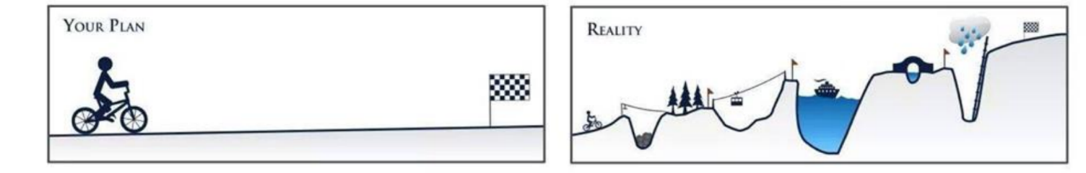
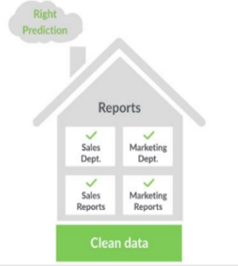

Recap
Data pre-processing (a.k.a. data preparation) is the process of manipulating or pre-processing raw data from one or more sources into a structured and clean data set for analysis. It is an important part of Data Analytics.
Notes:
So, just a recap, Data pre-processing (a.k.a. data preparation) is the process of manipulating or pre-processing raw data from one or more sources into a structured and clean data set for analysis. It is an important part of Data Analytics. When the data has been fully prepared, it is then ready for further analysis like classification, association, prediction, and clustering of data
Generally speaking, it can be regarded as everything you do before the actual modelling.
It sounds direct but it is full of challenges.
It is very time consuming , accounting for almost 80% of the data analysis work.
And the motivation is to build good foundation for further actions so that we can get meaningful and accurate results

Slide 7
Table of Content
Definition, context, and collecting data
Data integration (join tables)
Data cleaning (missing values, outliers, data types)
Data reduction (correlation check, PCA, sampling)
Data transformation (normalisation, one-hot encoding)
Notes:
There’s no clear recipe or standard for data preprocessing. Usually it includes various tasks and considerations, e.g.
So today, let’s start by data cleaning.

Slide 8

Data Cleaning - Quality Issues
Data in the real world is dirty:
Incomplete or missing: lacking attribute values or certain attributes of interest, or containing only aggregate data,
e.g., occupation=“ ” (missing data), Jan. 1 as everyone’s birthday? (disguised missing data)
Inaccurate or noisy: containing errors or outliers,
e.g., salary=“-10” (an error)
Inconsistent: containing discrepancies in codes or names,
e.g., age = “42” and birthday=“03/07/1997”
Notes:
Data quality can be reviewed from multiple dimensions. Whether the data is complete, whether the data is accurate, whether the data is consistent. So on and so forth.
In this sense, Data in the real world is often dirty, e.g., it can miss certain attribute values or even certain attributes, or containing only aggregate data,
e.g., occupation could be empty, or a less obvious example is that Jan. 1 as everyone’s birthday
And also Inaccurate or noisy which means data contain errors or outliers,
e.g., salary as a negative value which is very questionable
It can also be Inconsistent when data contain discrepancies in codes or names,
e.g., when age = “42” but birthday indicates the entity was born in 1997

Slide 9
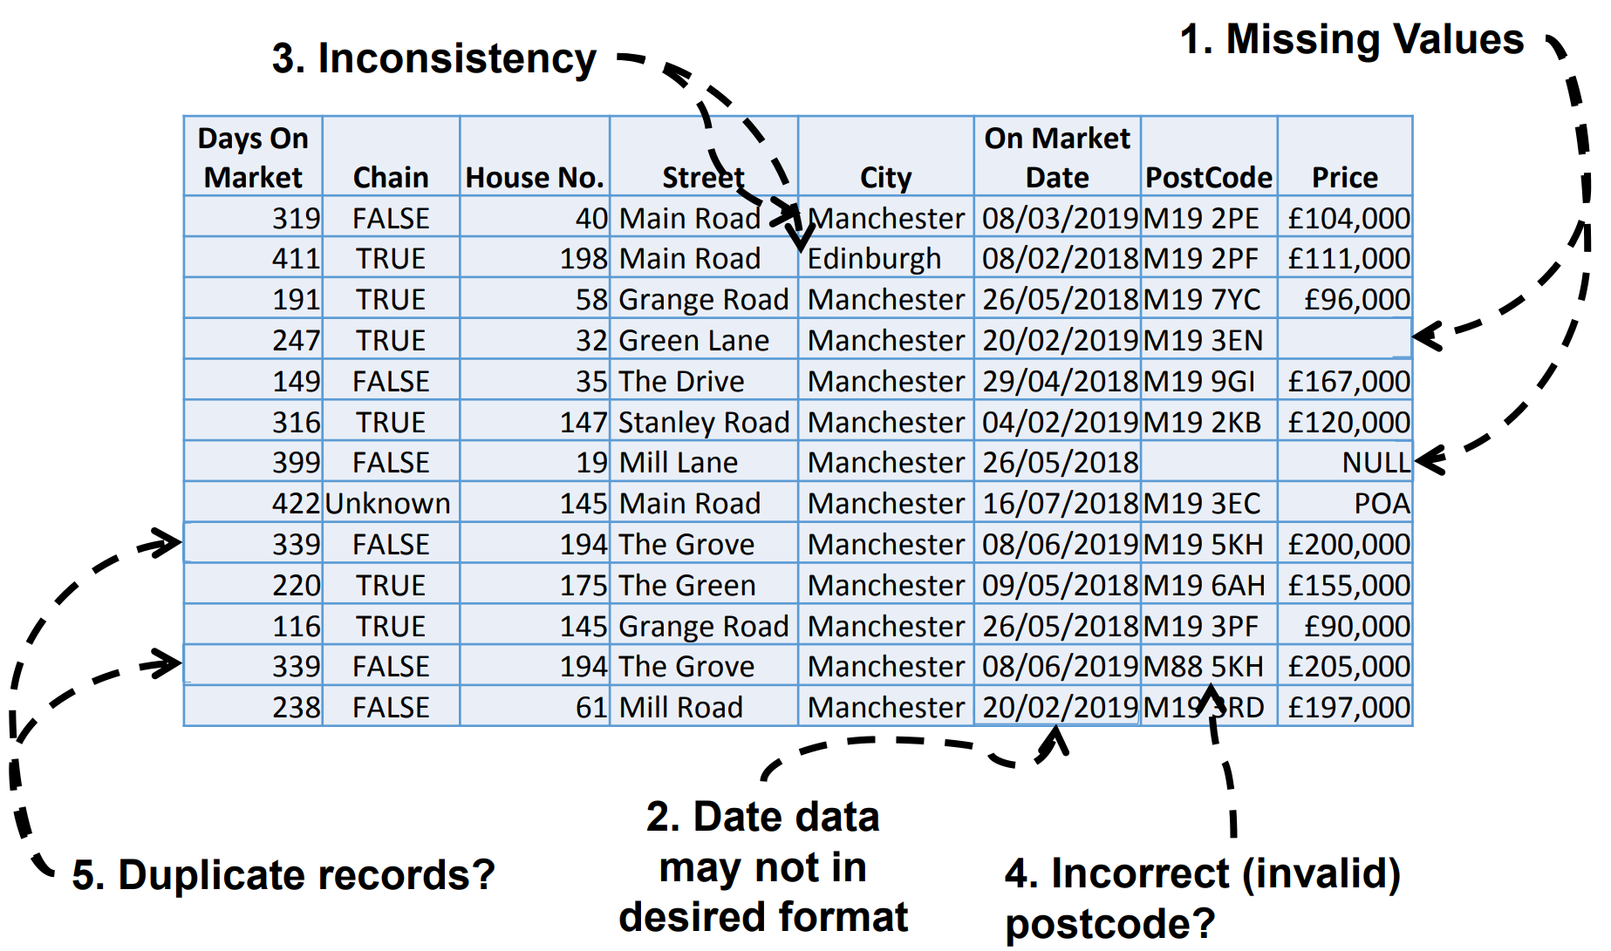
Dirty Data – Example
p54
Notes:
Here is an example of a very dirty dataset,
Missing values, some shown as null, some as unknown, and some is just empty
Date column may not in the desired format if we want to show month first and then date and year
If this is a report for Manchester only, and we have the postcode and streetname for Manchester, then the Edinburgh here is definitely an error
Also the postcode M88 doesn’t sound very reliable
And if take a closer look, two rows seems to belong to the same entity
If we put this data directly into use, then it’s not likely to get useful and accurate results

Slide 10
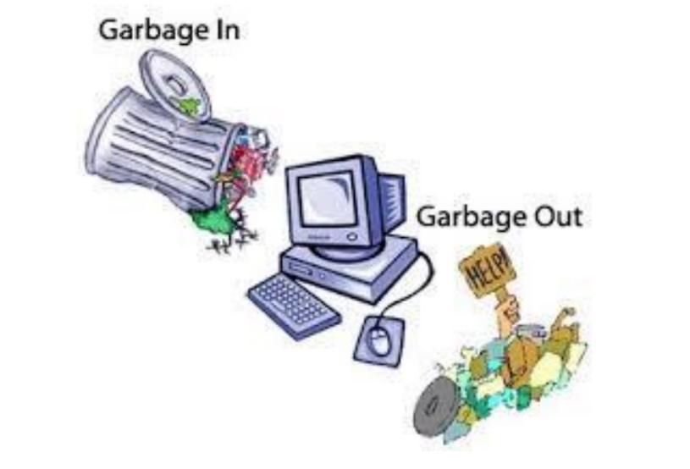
Why Data Cleaning?
“Data cleaning is one of the three biggest problems in data warehousing”— Ralph Kimball
“Data cleaning is the number one problem in data warehousing”— DCI survey
Quality data beats fancy data mining algorithms
Notes:
So why data cleaning? Well it’s been acknowledged that xx, xx, and xx.
We do data cleaning to avoid what data scientists call as GIGO, which stands for xx.

Slide 11
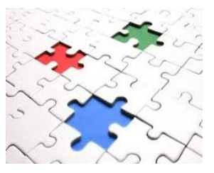
Incomplete (Missing) Data
Data is not always available
E.g., many rows have no recorded value for several attributes, such as customer income in sales data
Missing data may be due to
Equipment malfunction
Inconsistent with other recorded data and thus deleted
Data not entered due to misunderstanding
Certain data may not be considered important at the time of entry
No recorded history or changes of the data
Notes:
Let’s look at missing data first, and then noisy data later.
Incomplete data, or missing data means that data is not available, e.g. many rows have no recorded value for several attributes, such as customer income in sales data
Missing data may be due to
Equipment malfunction
Or Inconsistent with other recorded data and thus deleted, well it might be done on purpose to survive through some auditing
Or Data was not entered due to misunderstanding
Or maybe it’s not considered important at the time of entry
Or, there’s No recorded history or changes of the data

Slide 12

No Easy Fix for Missing Values
Throw out the records with missing values?
■ No? This creates a bias for the sample
Delete the column with missing values?
■ No? Only if the column data is unnecessary
Replace missing values with a “special” value (e.g., -99)?
■ No. This resembles any other value to data analytics.
Replace with some “typical” value? mean, median, or mode?
■ Maybe. Possible changes to the distribution.
Impute a value? (Imputed values should be flagged.)
■ Maybe. Use distribution of values to randomly choose a value.
Use data mining techniques that can handle missing values?
■ Yes. For example, decision tree can be applicable.
Partition records and build multiple models?
■ Yes. This is possible when data isn’t insufficient.
Notes:
We definitely need to deal with the missing values, but there’s no easy fix for missing values. There are several solution and you might find them helpful based on your context.
e.g. we can Throw out the records with missing values?
■ it’s a way, but not much preferred as This creates a bias for the sample, we need to think whether the missing values are missing at random or not at random).
We can Delete the column with missing values?
■ No? If the column data is unnecessary, otherwise inapplicable.
Replace missing values with a “special” value (e.g., -99)?
■ No. This resembles any other value to data analytics.
Replace with some “typical” value? mean, median, or mode?
■ Maybe. Possible changes to the distribution.
Impute a value? (Imputed values should be flagged.)
■ Maybe. Use distribution of values to randomly choose a value.
Use data mining techniques that can handle missing values?
■ Yes. For example, decision tree can be applicable.
Partition records and build multiple models?
■ Yes. This is possible when data isn’t insufficient.
These are just some solutions and inspirations. You can also do some other actions, e.g. introduce another data set which contain the missing information you need, but remember to be careful when integrating another data set.

Slide 13
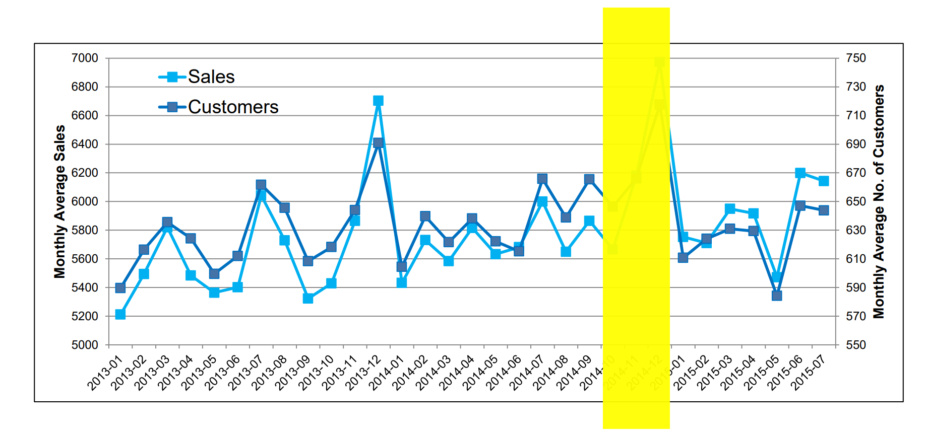
No Easy Fix – Time Series Data
How to find and impute these missing data?
Notes:
And here’s an example of how tricky the task can be. This is a time series data for xx and xx from xx to xx. Here we miss the information for oct, nov, and dec. Apparently we cannot just impute the values from the mean or median of the rest of records. As we know that dec might be a peak, higher than the rest. We can not just delete the three months as well. It seems that the best way is to get information from the same month of last year, even thought we cannot be 100% confident that 2014 has the same trend as 2013

Slide 14

Inaccurate (Noisy) Data
Noise: random error or variance in a measured variable
Incorrect attribute values may be due to
Faulty data collection instruments
Data entry problems
Data transmission problems
Technology limitation
Inconsistency in naming convention
Notes:
In term of inaccurate, or noisy data
Noise: random error or variance in a measured variable
Similar to reasons of missing data, Incorrect attribute values may be due to
Faulty data collection instruments
Data entry problems
Data transmission problems
Technology limitation
Inconsistency in naming convention

Slide 15
How to Handle Noisy Data?
Binning and smoothing
Sort data and partition into bins (equal-width, equal-depth)
Smooth by bin means, median, or boundaries, etc.
Regression
Smooth by fitting the data into a function with regression
Clustering
Detect and remove outliers that fall outside clusters
Combined computer and human inspection
Detect suspicious values and check by human (e.g., deal with possible outliers)
Notes:
How to handle noisy data?
We can do Binning and smoothing. We can
Sort data and partition into bins, either by (equal-width or by equal-depth)
And then Smooth the data by bin means, median, or boundaries, etc.
We can also adopt Regression and Smooth the data by fitting the data into a function with regression
We can do Clustering to Detect and remove outliers that fall outside clusters
Last not but not least, we can Combine computer and human inspection to Detect suspicious values, e.g., deal with possible outliers. This is very common

Slide 16
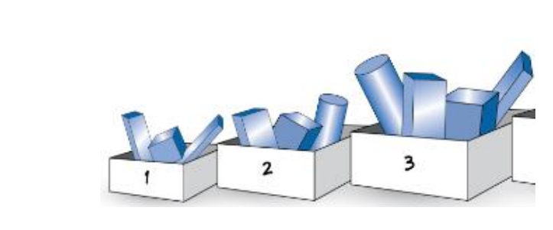
Binning Methods for Data Smoothing
Sorted data for price (in dollars): 4, 8, 9, 15, 21, 21, 24, 25, 26, 28, 29, 34
• Partition into 3 frequency (equal-depth) bins:
Bin 1: 4, 8, 9, 15
Bin 2: 21, 21, 24, 25
Bin 3: 26, 28, 29, 34
Smoothing by bin means:
Bin 1: 9, 9, 9, 9
Bin 2: 23, 23, 23, 23
Bin 3: 29, 29, 29, 29
• Smoothing by bin boundaries:
Bin 1: 4, 4, 4, 15
Bin 2: 21, 21, 25, 25
Bin 3: 26, 26, 26, 34
Notes:
Here I’d like to talk about xx in detail. Suppose that we have 12 Sorted data for price ranging from 4 to 34, we can partition them into 3 frequency (equal-depth) bins:
If we do Smoothing by bin means, so that xxx
Alternatively, if we Smooth by bin boundaries, so that xxx
In this way, we minimize the effects of small observation errors. We also reduce the chances of overfitting in case of small datasets

Slide 17
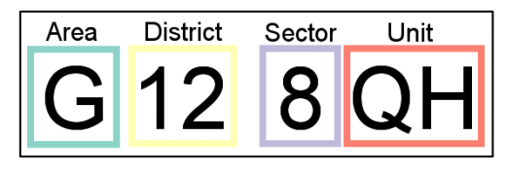
Other relevant concepts
Data scrubbing: use simple domain knowledge (e.g., postal code, spell-check) to detect errors and make corrections
Data auditing: analyse data to discover rules and relationship to detect violators (e.g., correlation and clustering to find outliers)
Data validating: value range checks, regular expressions, uniqueness checks
Notes:
Other concepts related to data cleaning include xx.
Unfortunately usually manual work is essential to cleaning the data, as a lot of common sense hasn’t been programmed. E.g., the postcode, you might have to check on your own to make sure that all postcodes are real, correct and accurate.
This usually take a lot of time and a lot of domain knowledge . And that's kind of explaining why data preprocessing can account for almost 80% of the work

Slide 18
Table of Content
Definition, context, and collecting data
Data integration (join tables)
Data cleaning (missing values, outliers, data types)
Data reduction (correlation check, PCA, sampling)
Data transformation (normalisation, one-hot encoding)
Notes:
And now let’s move to data reduction.

Slide 19
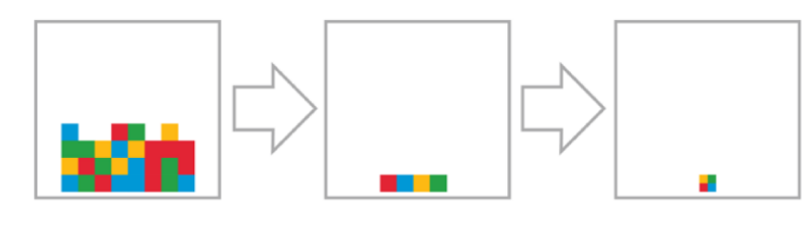
Data Reduction
Why data reduction?
A database/data warehouse may store terabytes of data
Complex analysis may take a very long time to run on the complete data set
Data reduction
Obtain a reduced representation of the data set - much smaller in volume but yet produces almost the same analytical results
Notes:
So Why data reduction?
Quite simple. In the age of Big data, A database/data warehouse may store terabytes of data, if not more.
Complex analysis may take a very long time to run on the complete data set, and usually come with significant computational complexity
Data reduction Means that people can Obtain a reduced representation of the data set - much smaller in volume but yet produces almost the same analytical results

Slide 20
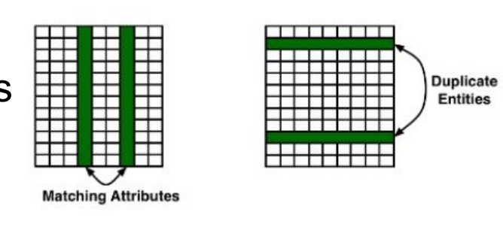
Data Reduction During Integration
Redundant data is often created when integrating multiple databases
Column-oriented: the same attribute may have different names in different databases
Row-oriented: duplicate entities, etc.
Notes:
Firstly, Data Reduction is almost always possible During data Integration
Redundant data is often created when integrating multiple databases
it can be either Column-oriented, as the same attribute may have different names in different databases
Or Row-oriented for duplicate entities, etc.
Therefore, Careful integration of the data from multiple sources may help reduce/avoid redundancies and inconsistencies and improve the efficiency and quality of data analytics.
Or just remember to check the shape of merged datasets at the end

Slide 21
Data Reduction Strategies
Dimensionality reduction
Remove redundant and irrelevant attributes
Principal component analysis (PCA)
Variable clustering
Featuring engineering
Numerosity reduction
Sampling techniques
Regression and log-linear models
Histograms, clustering
Notes:
There are two data reduction strategies.
First is Dimensionality reduction
Remove data with poor quality (e.g., many missing values, large number of categories, zero-variance)
Remove redundant and irrelevant attributes or variables
Principal component analysis (PCA), Variable clustering and/or Featuring engineering
Second is Numerosity reduction, or data reduction
We can adopt Sampling techniques, or do Regression and log-linear models so to just keep the model and abandon the data, or maybe Histograms and clustering
These methods are less common but still solutions to deal with large data size

Slide 22
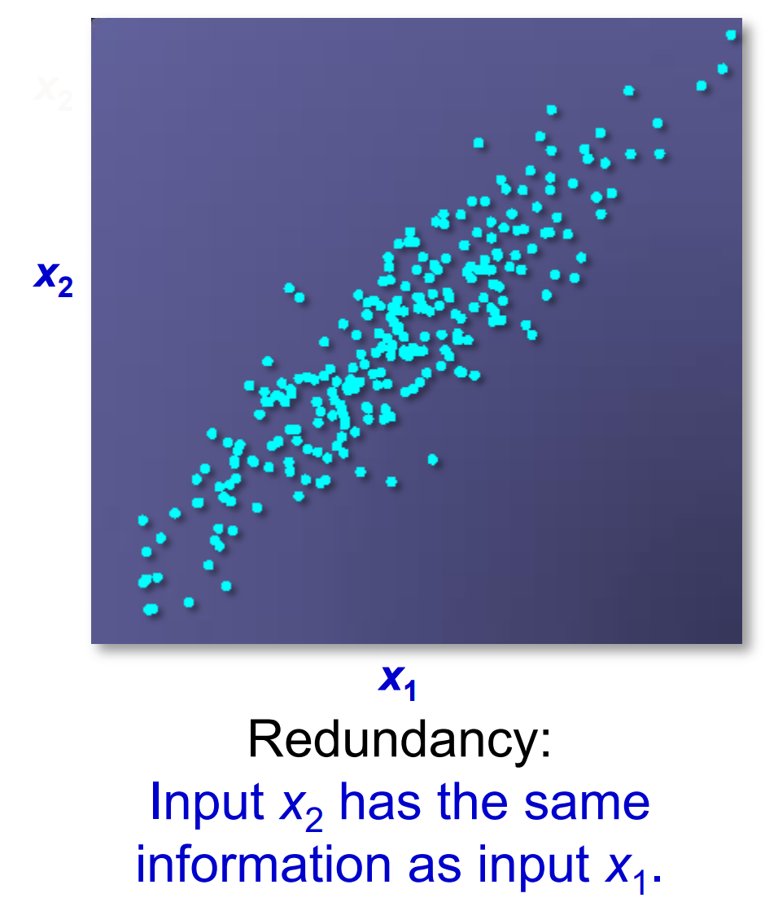
Variable Reduction – Correlation analysis
Notes:
Here’s an examples. we can see that Input X2 has the similar information as input X1, as they are positively correlated. If X1 has certain relation to the output, then we can just use x1 to approximate the relation between x2 and the output, and vice versa. In this sense 1 of them is actually redundant and we can just keep the other.

Slide 23
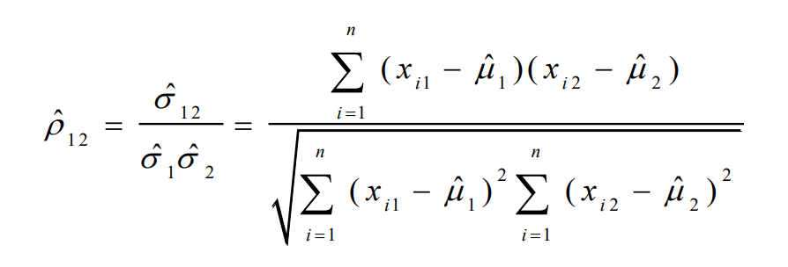
Correlation Analysis – Numerical Variables
Correlation between two variables x1 and x2 is the standard covariance, obtained by normalising the covariance with the standard deviation of each variable.
Sample correlation for two attributes x1 and x2: where n is the number of samples, µ1 and µ2 are the respective means, σ1 and σ2 are the respective standard deviation of x1 and x2
Notes:
So this is correlation analysis.
Correlation between two variables x1 and x2 is the standard covariance, obtained by normalising the covariance with the standard deviation of each variable.
Sample correlation for two attributes x1 and x2 can be computed with the following equation. where n is the number of samples, µ1 and µ2 are the respective means, σ1 and σ2 are the respective standard deviation of x1 and x2

Slide 24
Correlation Analysis – Numerical Variables
Sample correlation for two attributes x1 and x2: where n is the number of tuples, µ1 and µ2 are the respective means, σ1 and σ2 are the respective standard deviation of x1 and x2
If ρ12 > 0: x1 and x2 are positively correlated (x1 ’s values increase as x2 ’s increase)
If ρ12 = 0: independent
If ρ12 < 0: negatively correlated
Notes:
If ρ12 > 0: x1 and x2 are positively correlated (x1 ’s values increase as x2 ’s increase)
If ρ12 = 0: independent
If ρ12 < 0: negatively correlated

Slide 25
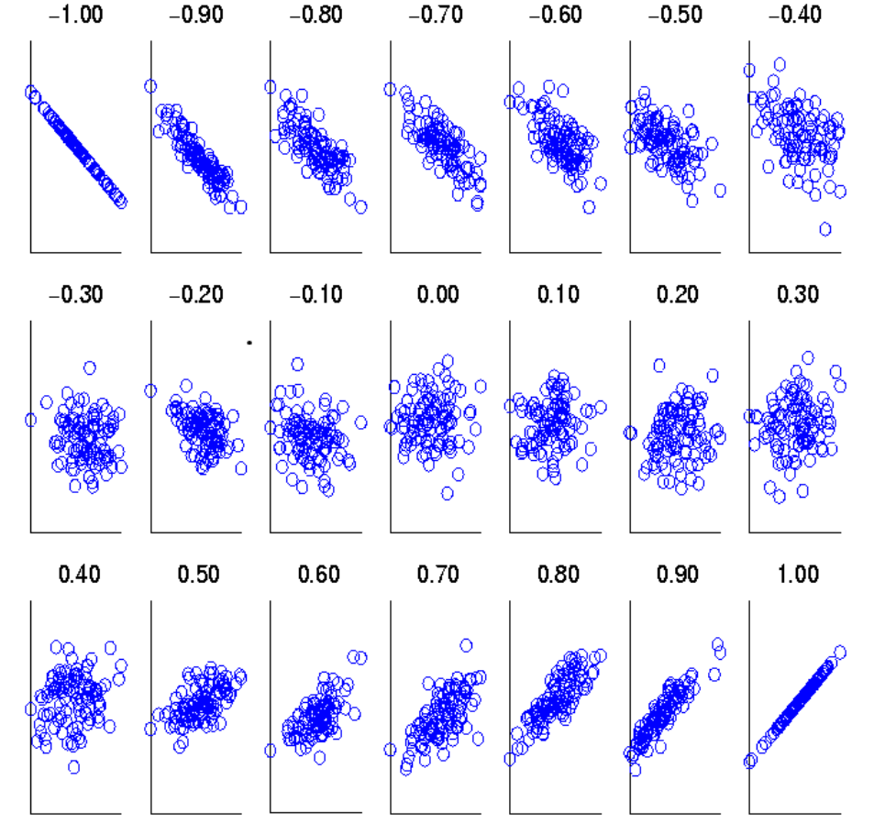
Visualising Correlation Coefficients
Correlation coefficient value range: [–1, 1]
Notes:
Correlation coefficient value range: [–1, 1]
These scatter plots demonstrate sets of points and their correlation coefficients changing from –1 to 1

Slide 26
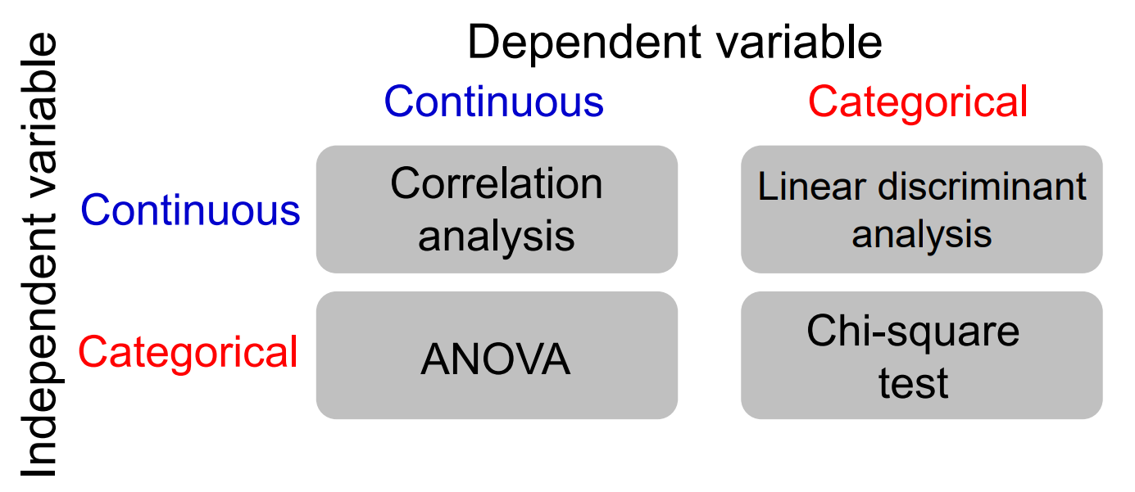
Correlation Analysis
Methods for testing correlation/ dependence/ association between independent and dependent variables
Notes:
Different Methods are used for testing correlation between different types of variables
If both variables are continuous variables, xx

Slide 27
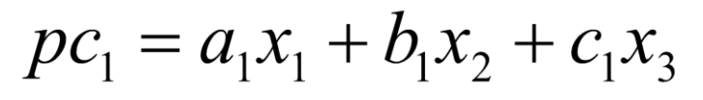
Variable Reduction – Principal Component Analysis
Principal components are constructed as mathematical transformations of the input variables. Each is an uncorrelated, linear combination of original input variables.
The coefficients of such a linear combination are the eigenvectors of the correlation or covariance matrix.
The principal components are sorted by descending order of the eigenvalues.
The eigenvalues represent the variances of the principal components.
Notes:
Principal components are constructed as mathematical transformations of the input variables. Each is an uncorrelated, linear combination of original input variables. The components can be written as a sum of loadings onto variables,
e.g. Xx, where e.g. a1, b1, c1 are called as loadings
The coefficients of such a linear combination are the eigenvectors of the correlation or covariance matrix.
The principal components are sorted by descending order of the eigenvalues.
The eigenvalues represent the variances of the principal components.
PCA is by far the most popular dimensionality reduction technique, especially if there are many many attributes, like million of attributes, then we can just use 100 PCs to capture their variance, as A small number of principal components can be kept to explain a lot of the variation in the data cloud.
But the disadvantage is that it’s Difficult or impossible to interpret the constructed principal components.

Slide 28
Numerosity Reduction
Non-parametric methods
Do not assume models
E.g. Sampling, clustering, histograms, etc.
Parametric methods
Assume the data fits some model, estimate model parameters, store only the parameters, and discard the data
E.g. regression, log-linear models
Notes:
In terms of numerosity reduction. On the one hand is Non-parametric methods, where we do not assume models. Common methods include Sampling, clustering, histograms, etc.
On the other hand is Parametric methods where we Assume the data fits some model, estimate model parameters, store only the parameters, and discard the data (except possible outliers) E.g. regression, log-linear models

Slide 29
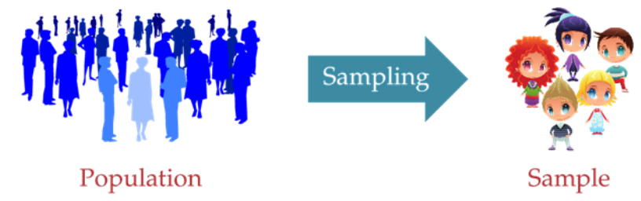
Sampling
Sampling: obtaining a small set of samples to represent the whole data set
Simple random sampling
Sampling without replacement
Sampling with replacement
Stratified sampling
Notes:
For the reason of time, I can just expand on Sampling methods, which is the most common one I think.
Sampling means obtaining a small set of samples to represent the whole data set (assuming that the computational complexity is potentially sub-linear to the size of the data)
Simple random sampling means There is an equal probability of selecting any particular object
Sampling without replacement means that Once an object is selected, it is removed from the population
Whereas Sampling with replacement means A selected object is not removed from the population
Last but not least is Stratified sampling: where it is required to Approximate the percentage of each class in the overall database before drawing the samples. It is usually Used in conjunction with skewed data

Slide 30
Table of Content
Definition, context, and collecting data
Data integration (join tables)
Data cleaning (missing values, outliers, data types)
Data reduction (correlation check, PCA, sampling)
Data transformation (normalisation and one-hot encoding)
Notes:
So that’s it for data reduction. The last section of today is data transformation.

Slide 31
Data Transformation
A function that maps the entire set of values of a given attribute to a new set of replacement values, s.t., each old value can be identified with one of the new values
Relevant methods:
Normalisation/ Standardisation: scale data to fall within a smaller, specified range
» min-max normalisation
» z-score normalisation
» normalisation by decimal scaling
Notes:
Data transformation is A function that maps the entire set of values of a given attribute to a new set of replacement values, Such that each old value can be identified with one of the new values. It’s very helpful and necessary if you have features at different scale, e.g. weight and income of a person. Many actions, like PCA requires normalisations in advance to guarantee their performance.
Relevant methods: is Normalisation/ Standardisation: which scales data to fall within a smaller, specified range, including
» min-max normalisation
» z-score normalisation
» normalisation by decimal scaling

Slide 32
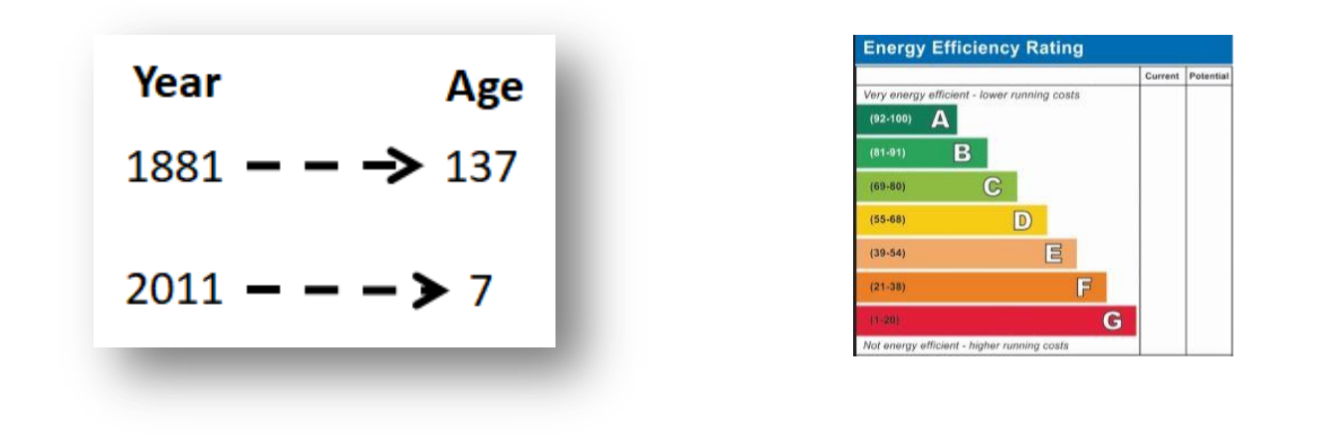
Data Transformation Examples
Standardise numeric values
Change counts into percentages.
Translate dates to durations.
Capture trends with ratios, differences, etc.
Replace categorical values with appropriate numeric values
Notes:
There are several different Data Transformation Methods, each for different purposes.
e.g. Standardise numeric values so that all numeric values are replaced by the notion of “how far is this value from the average?” Standardisation is useful, although it sometimes has no effect on the results (such as for decision trees and regression)
We can also Change counts into percentages, Translate dates to durations, Capture trends with ratios, differences, etc.
And also Replace categorical values with appropriate numeric values, as many techniques work better with numeric values
The example on the left is transform year into age if the current year is 2018. and on the left, the rating a to g can be transformed to the median scores of their respective band.

Slide 33
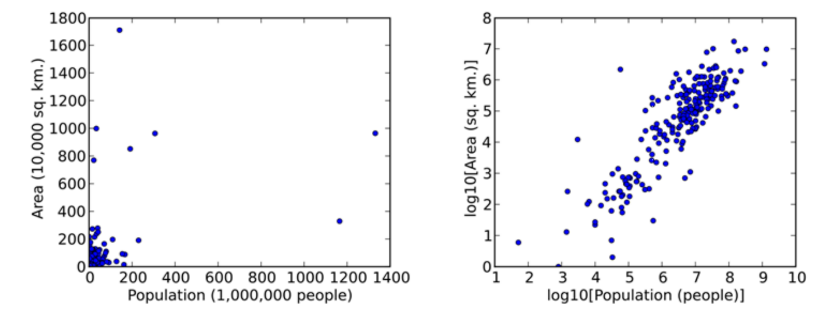
Data Transformation – Examples cont.
Transform variables to bring information to the surface.
Transform using mathematical functions, such as logs, reciprocal, or square root, for “stretching” and “squishing”
Notes:
We can also transform data bring information to the surface, simply by using mathematical functions, such as logs, reciprocal, or square root, for “stretching” and “squishing” data
Here’s another example of using logarithm to zoom in the patterns of the data.

Slide 34
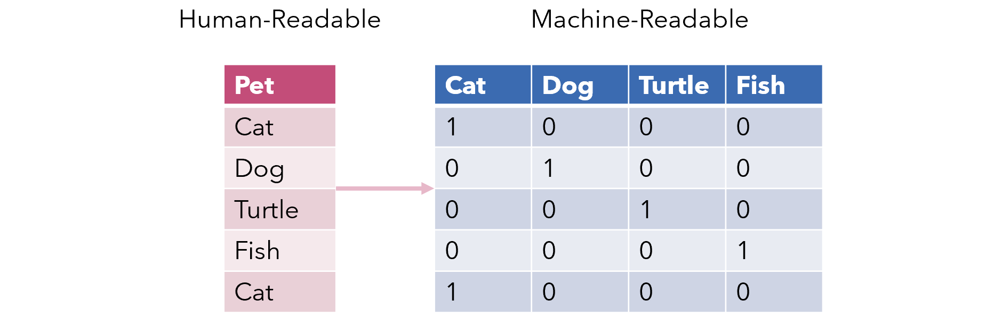
One-hot Encoding
Use binary variables to replace a categorical feature.
Notes:
One hot encoding is a very common data transformation. Where binary variables are used to replace a categorical feature
Some algorithms can work with categorical data directly.For example, a decision tree.
But Many machine learning algorithms cannot operate on label data directly. They require all input variables and output variables to be numeric. This means that categorical data must be converted to a numerical form. e.g. here the 4 categories are transformed into 4 new attributes.
If the categorical variable is an output variable, you may also want to convert predictions by the model back into a categorical form in order to present them or use them in some application.

Slide 35
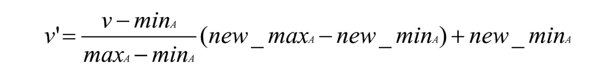
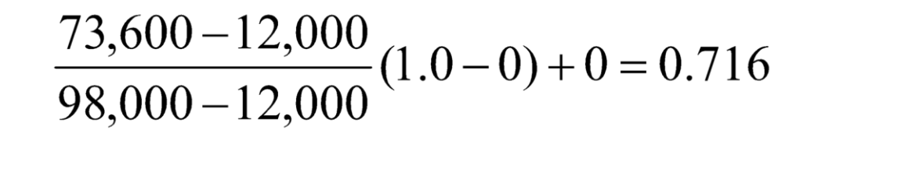
Min-Max Normalisation
min-max normalisation
Example – income, min £12,000, max £98,000 – map to 0.0 – 1.0
£73,600 is transformed to:
Notes:
Min-max normalization is one of the most common ways to normalize data. For every feature, the minimum value of that feature gets transformed into a 0, the maximum value gets transformed into a 1, and every other value gets transformed into a decimal between 0 and 1
For Example – if the min of income is £12,000, and the max is £98,000, then we map the two boundaries into 0.0 – 1.0, and thus £73,600 is transformed to: 0.716

Slide 36
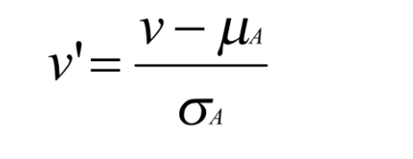
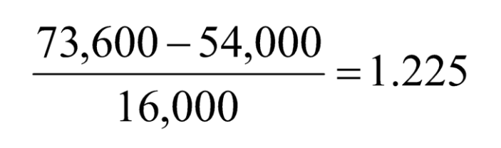
Z-score Normalisation
z-score normalisation (μ: mean, σ: standard deviation)
z-score: The distance between the raw score and the population mean in the unit of the standard deviation
Let μ = 54,000, σ = 16,000.
Notes:
Z-score normalisation is another common method. Simply put, a z-score (also called a standard score) gives you an idea of how far from the mean a data point is. But more technically it is The distance between the raw score and the population mean in the unit of the standard deviation
Given the example in last case, the mean is 54000 and std is 16000, therefore the income 73600 is transformed into 1.225

Slide 37
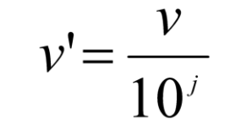
Normalisation by Decimal Scaling
Normalisation by decimal scaling
where j is the smallest integer such that Max(| v’|) <1
Example — recorded values from -722 to 821
Divide each value by 1000
-28 normalised to -.028
444 normalised to 0.444
Notes:
Last but not least is normalisation by decimal scaling. It’s relatively more straightforward. The new value is equal to the old value divided by 10 to the jth power where j is the smallest integer such that Max of the absolute value of v’ is smaller than 1
e.g. given a set of values ranging from -772 to 821, we can divide each value by 1000 and then -28 is normalises to -.028 and 444 normalises to 0.444

Slide 38
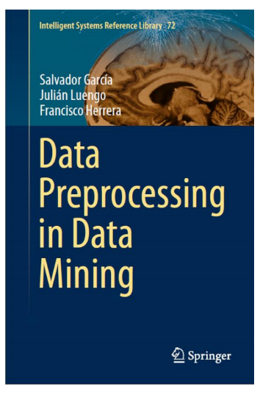
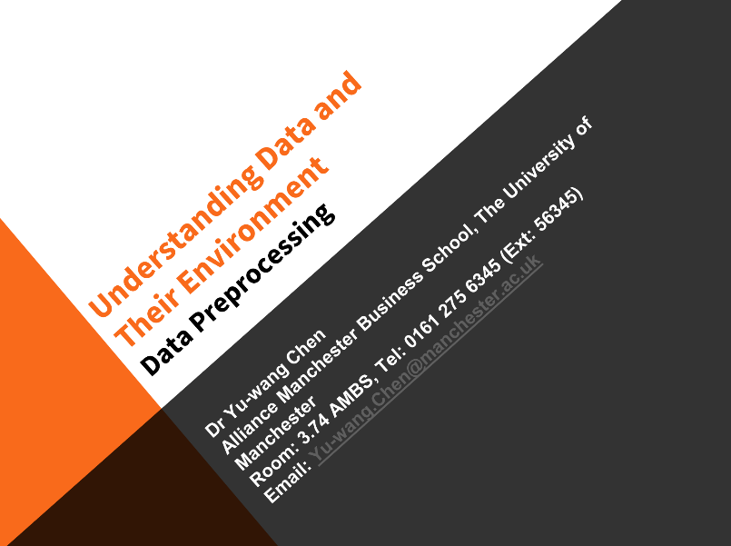
Acknowledgement
Some of the content is based on …
García, S., Luengo, J. and Herrera, F., 2015. Data preprocessing in data mining New York: Springer.
Yu-wang Chen. “Understanding Data and Their Environment- Data Preprocessing” (2019)

Slide 39
You might be interested in...
Upcoming events:
Online workshop: Data Pre-processing Methods in Python, on 1pm Jan28
Online workshop: Techniques and Methods of Analysis for Social Network Data, on 2pm Jan 27
UK Data Service Computational Social Science Drop-in, on 1pm Feb 9
Recent events:
Text-mining series
Social Network Analysis series
Data in the spotlight: UK and cross-national surveys
Notes:
Before we get into the q and a part, I just want to draw your attention to some upcoming events that you might find useful, such as: xxx
We have also held events on xx
You can also find our past events on UK Data service website and youtube channel.

Slide 40
Questions
Anran Zhao
anran.zhao@manchester.ac.uk

